Slide 1

Analysis of The Office Lines
August 2022

Slide 2

Data Source
Lines from every season was available on Kaggle
For this analysis, only lines up to season 7 were included (when Steve Carell left)
Lines of Michael, Dwight, Jim, Pam, and Angela analyzed
~14K lines analyzed
LDA Topic modelling (with MALLET) performed
Sentiment analysis, using VADER
Python script on Jupyter notebook

Slide 3

Volume by Theme

Slide 4
Topic Modelling
50 topics discovered and analyzed
Placed into 10 themes:
Character Relationships with Each Other
Character’s Activities
Dunder Mifflin Operations & Activities
Dunder Mifflin Politics
Family
Health & Wellbeing
Love, Sex, & Relationships
Social Issues & Miscellaneous
Socialization at Dunder Mifflin
Transportation & Life Outside Dunder Mifflin

Slide 5
Themes by Season

Slide 6

Sentiment by Theme

Slide 7
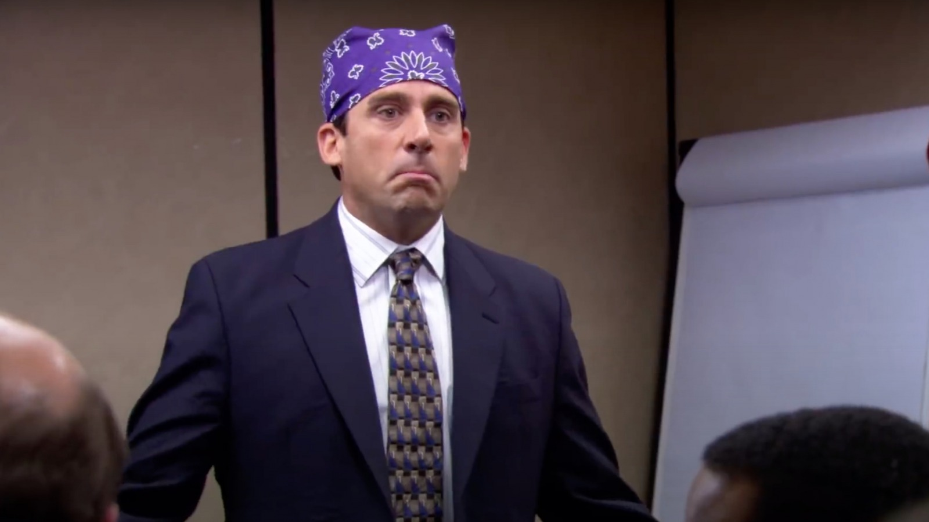
Sentiment by Season

Slide 8
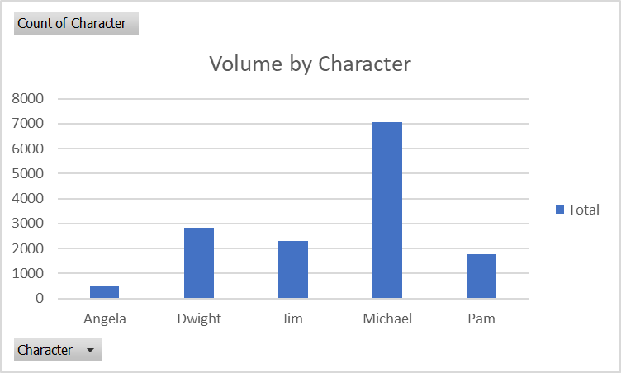
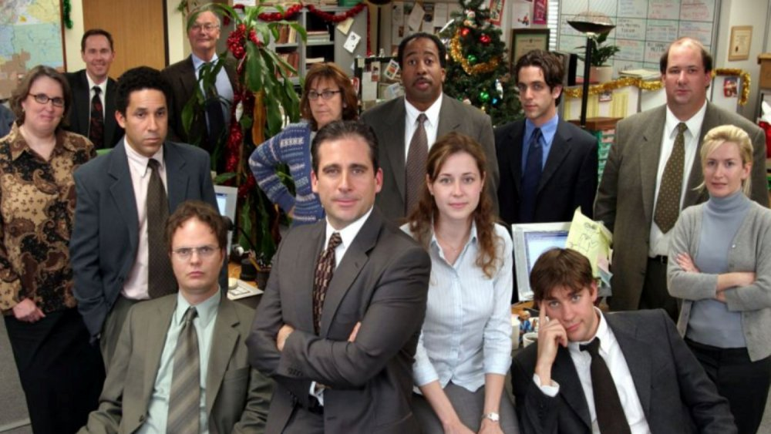
Volume by Character

Slide 9
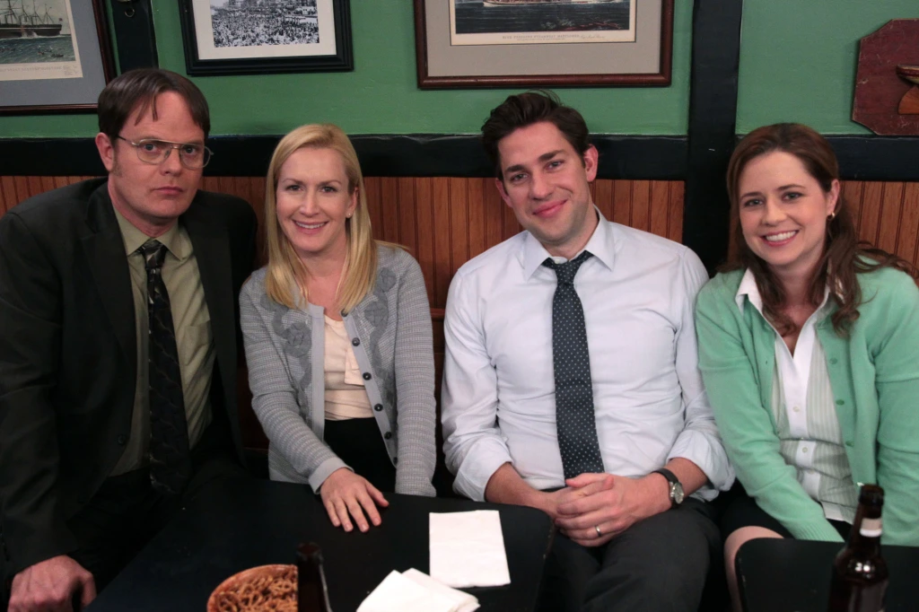
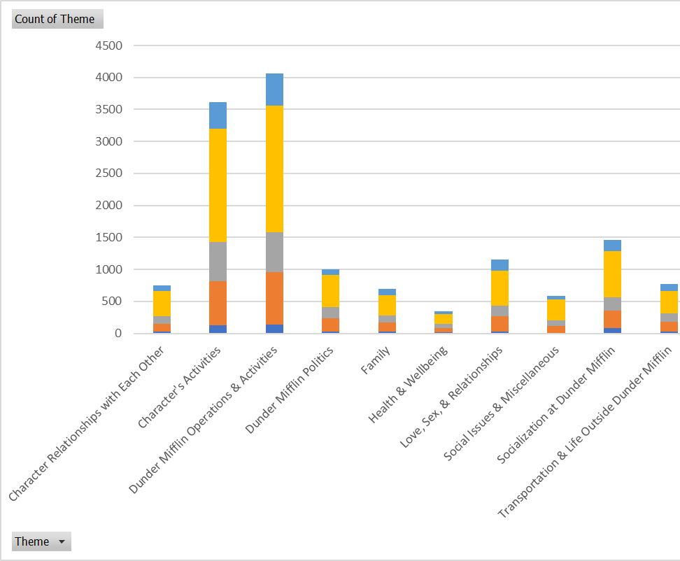
Theme by Character

Slide 10
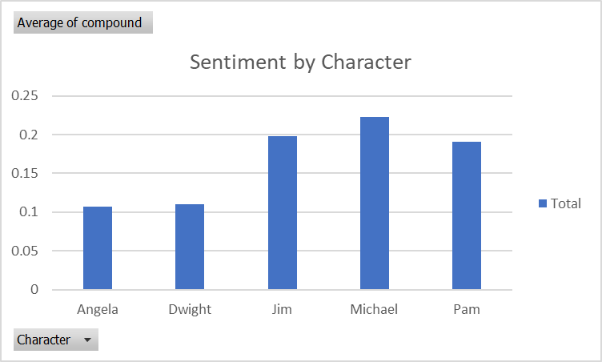

Sentiment by Character

Slide 11

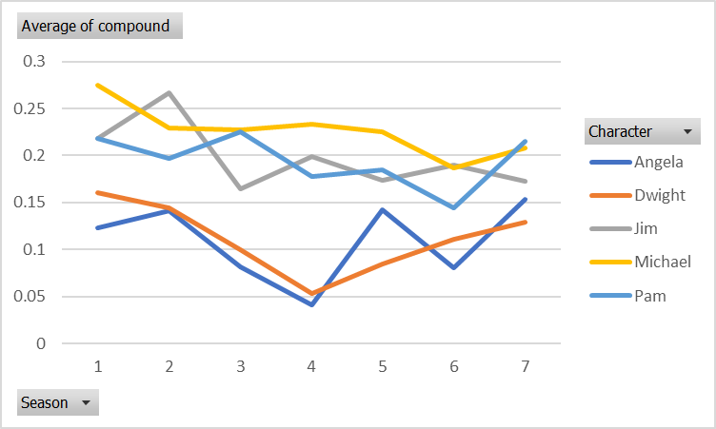
Character Sentiment by Season

Slide 12
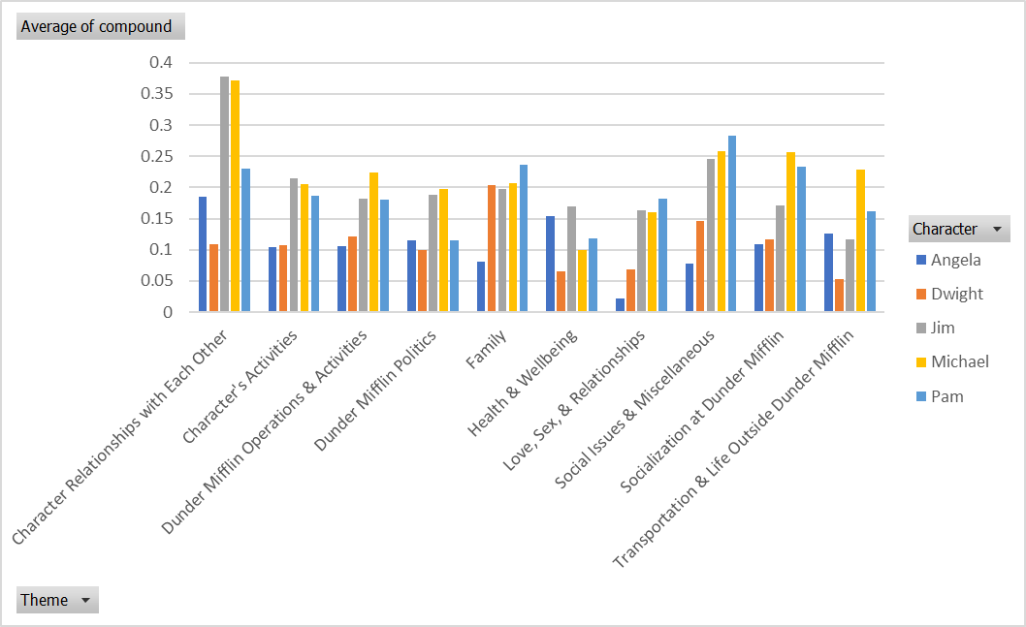

Character Sentiment by Theme

